Slide 1
Fashion Product Image Generation Using Diffusion Models
ARUN SOLAIAPPAN VALLIAPPAN
ABHINAV ADITHYA
NISHANTH MANOHARAN
PREETI PURNIMAA KANNAN

Slide 2
Problem Statement
Challenge
E-commerce platforms need high-quality product images for catalog generation, but traditional
photography is expensive and time-consuming.
Solution
-> Use Text-to-Image Diffusion Models to generate realistic fashion product images from text
descriptions automatically.
-> Generate photorealistic fashion images from text prompts
-> Optimize model parameters for best quality
-> Compare multiple diffusion architectures
-> Evaluate using standard generative metrics

Slide 3
Approach
This project builds an AI system that generates realistic fashion product images from text
descriptions.
We used the Fashion Product Images dataset (4,000 samples) and implemented a full workflow:
Data loading & preprocessing
CLIP text encoding
Diffusion-based image generation
Parameter tuning
Evaluation using CLIP Score, FID, and Inception Score
Final sample generation for gallery
This work follows a milestone-based pipeline from simple prompt → image generation to fully
evaluated model.

Slide 4
Dataset
-> The dataset used was ashraq/fashion-product-images-small, from HuggingFace
-> 4,000 training samples
-> Columns include gender, product type, color, season, year, usage, and product display name
-> Each entry contains image + text description
-> Data was cleaned and stored as fashion_cleaned.pkl
This dataset gives a wide variation of shirts, watches, handbags, shoes, and other apparel,
allowing the model to learn diverse visual patterns.

Slide 5
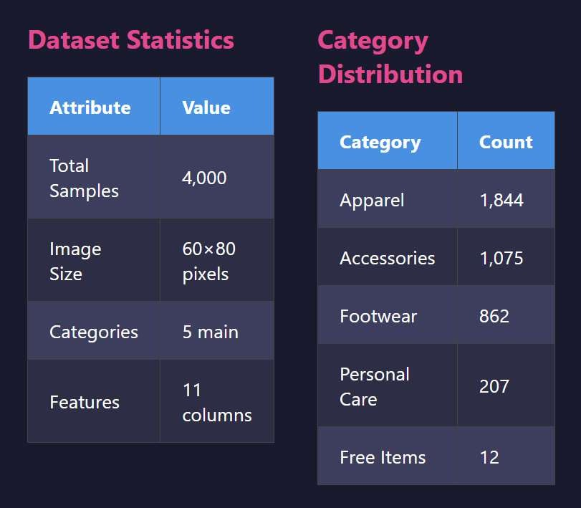
Dataset overview

Slide 6
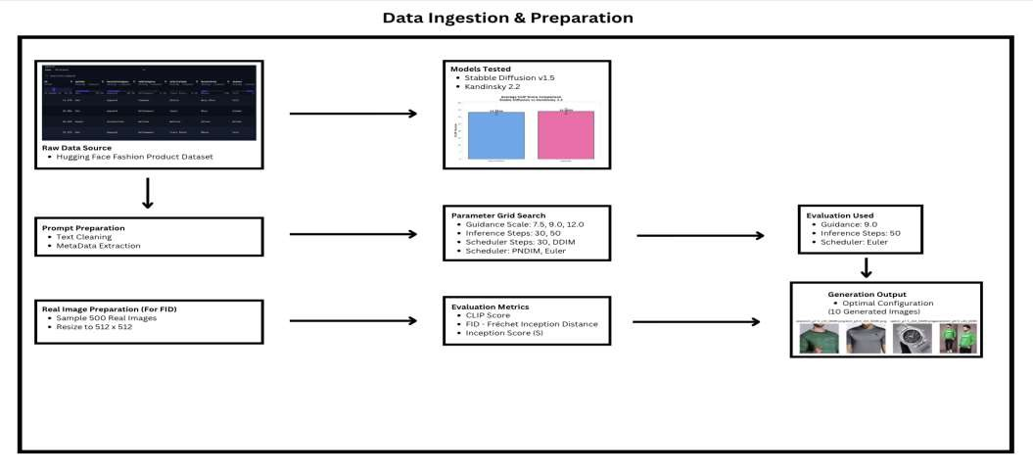
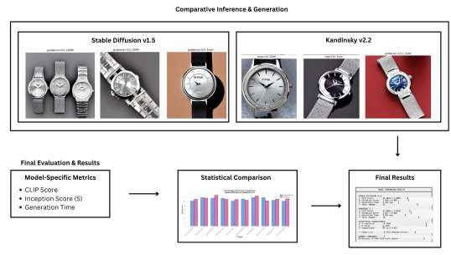
ARCHITECTURE DIAGRAM

Slide 7
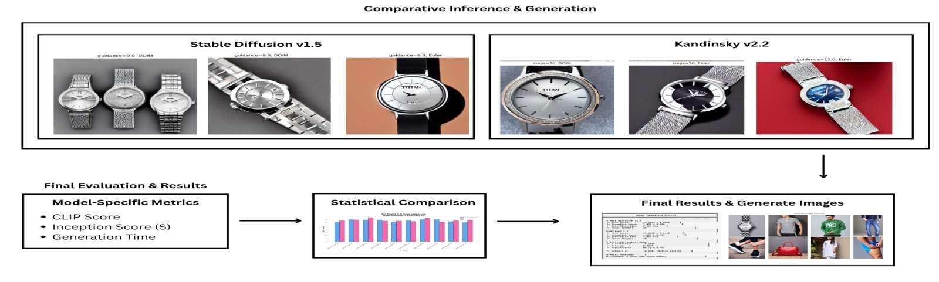

Slide 8
Pipeline Overview
Our workflow combines CLIP + Stable Diffusion:
CLIP Encoding
Converts product text into 512-dimensional embeddings
Helps Evaluate text–image alignment
Stable Diffusion
Generates product images from text prompts
Tested multiple parameters:
  Guidance: 7.5, 9.0, 12.0
  Steps: 30, 50
  Schedulers: Euler, DDIM, PNDM
Evaluation Framework
CLIP Score
FID Score (vs 300 real images)
Inception Score

Slide 9
CLIP Embedding & Prompt Testing
-> We first validated the CLIP model by generating embeddings for random product descriptions
-> CLIP successfully produced embeddings of shape [5,512]
-> Prompt-to-image generation was tested for 5 random text samples
-> The initial images confirmed that Stable Diffusion could interpret fashion descriptions, though
early results lacked sharpness
-> This step verified that the system was working end-to-end

Slide 10
Parameter Tuning
We ran controlled experiments across three parameters:
Guidance Scale
Values tested: 7.5, 9.0, 12.0
Number of Steps
Values tested: 30, 50
Scheduler
Euler, DDIM, PNDM
Observations:
Higher guidance → sharper but sometimes unrealistic images More steps → better details but slower
Euler generally gave the best CLIP scores

Slide 11
CLIP Score Evaluation
We evaluated alignment using CLIP across watch, shirt, and sweatshirt categories.
Watch: Mean = 0.325
Shirt: Mean = 0.331 Sweatshirt: Mean = 0.355
Range spanned 0.27 – 0.40, which indicates moderate but consistent alignment. Best CLIP Scores came from:
Guidance = 12
Scheduler = Euler / DDIM

Slide 12
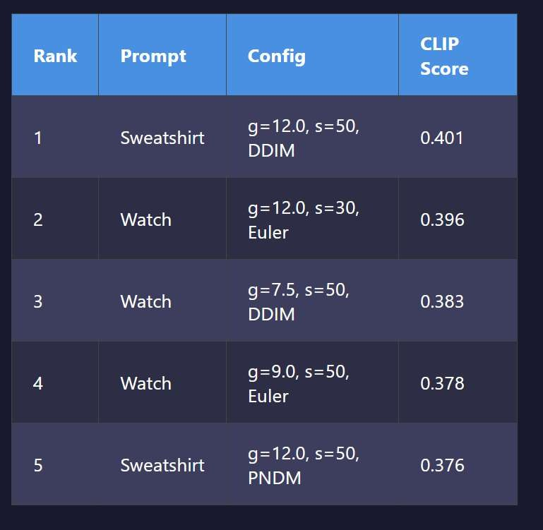
Top 10 Generated Images
We selected the top-scoring images based on
CLIP Score (Page 33–34).
Examples include:
sweatshirt_g12_s50_DDIM.png → Score: 0.401
watch_g12_s30_Euler.png → Score: 0.396
These images showed the best prompt
alignment and detail clarity.
A 10-image visual grid was produced for comparison.

Slide 13
Creating Real Image Set for FID
To compute FID, we created a folder of 300 real images taken from the dataset.
(This ensured a consistent reference point for calculating sample distribution quality)
This also follows the proper FID evaluation pipeline:
Real distribution
Generated distribution
Feature embedding comparison in Inception space

Slide 14
Final Model Selection
Guidance Scale: 9.0
Steps: 50
This configuration gave the best balance between clarity, accuracy, and computational cost.
Scheduler: Euler
Why Stable Diffusion?
-> 24% faster generation
-> Better FID score (185.22)
-> More consistent results
-> Extensive tuning data
-> CLIP difference not significant

Slide 15
Final Sample Generation
Using the final configuration, we generated:
✔ 50 large samples (prompts repeated 5× each)
✔ Stored in final_samples_large
Prompts included:
“women red leather handbag”
“white cotton kurta for women” “adidas mens fire grey t-shirt”
“black running shoes with white sole”

Slide 16
Evaluation: FID & Inception Score
FID Score (final large set):
185.21 (first evaluation)
294.72 (second evaluation with different samples)
This indicates room for improvement; images are meaningful but visually weaker than the real
dataset distribution.
Inception Score:
1.0000 ± 0.0000
Meaning: generated images lack diversity (common for small diffusion runs).
CLIP Score remained the strongest metric for alignment.

Slide 17
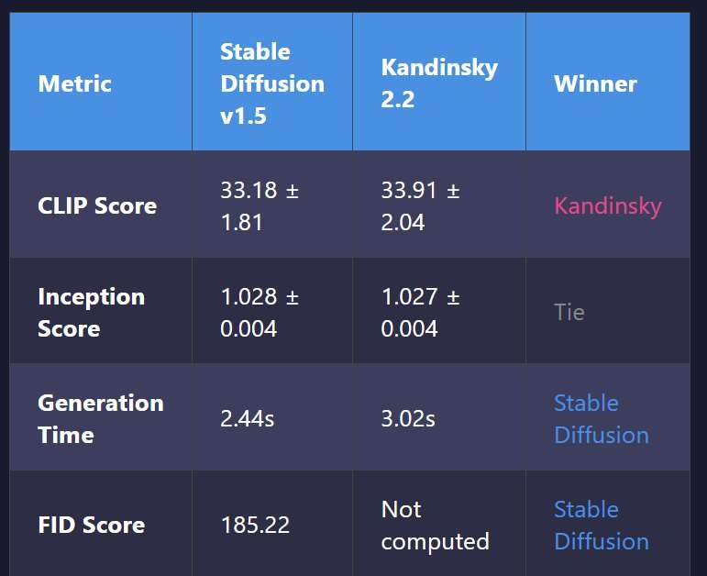
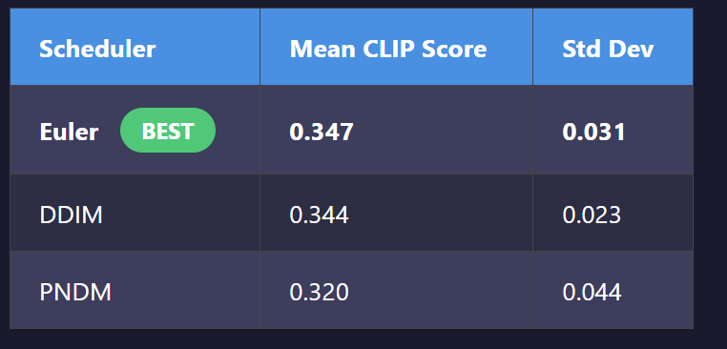
Results

Slide 18
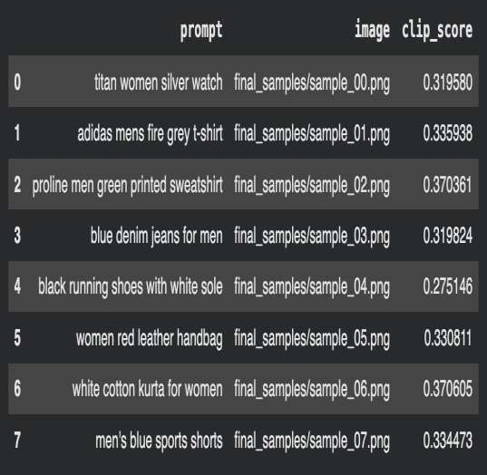
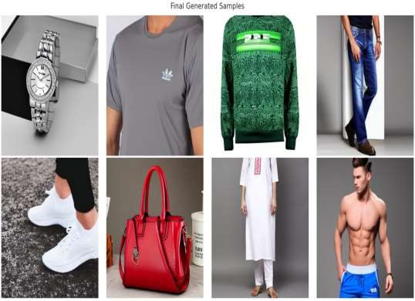
Prompt and the image generated

Slide 19
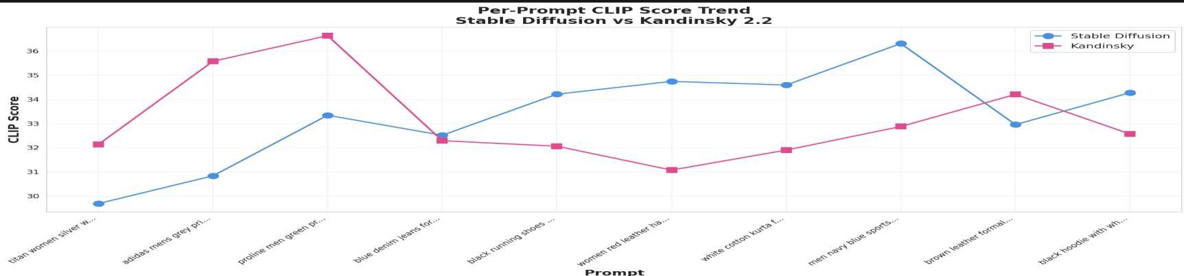
This chart compares CLIP alignment scores for each prompt between Stable Diffusion and Kandinsky 2.2. Kandinsky performs better on some clothing prompts, but Stable Diffusion shows more consistent scores across the full set.

Slide 20
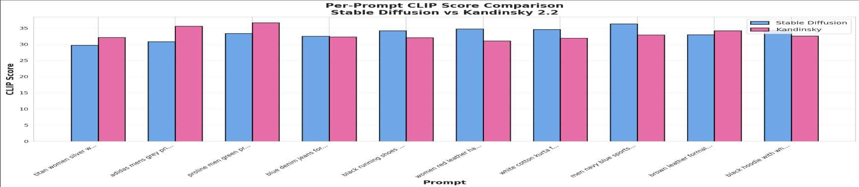
This chart compares the CLIP scores of Stable Diffusion and Kandinsky 2.2 across the same set of
prompts.
Kandinsky achieves slightly higher scores on several items, but Stable Diffusion remains more consistent
overall across all categories.

Slide 21
Final Gallery
Shows the 50 final generated images produced using the best-performing configuration.
Captures core clothing attributes accurately – color, category, and general shape.
Produces simple and clean backgrounds, keeping focus on the product.
Demonstrates good text-prompt alignment for shirts, watches, handbags, and footwear.
Some images show softness or minor artifacts, especially in detailed areas.
Logo, patterns, and fine textures are not always rendered correctly.
Highlights model strengths (overall structure, color accuracy) and
limitations (fine-grain texture realism, small text, or branding).

Slide 22
Ethical Considerations
→ AI-generated products can mislead users without labelling
→ Possible copyright issues when images resemble branded items
→ Dataset bias can amplify stereotypes
→ Diffusion models consume notable compute resources
Mitigation:
→ Clear labeling of AI images
→ Diverse datasets
→ Human review in real use cases

Slide 23
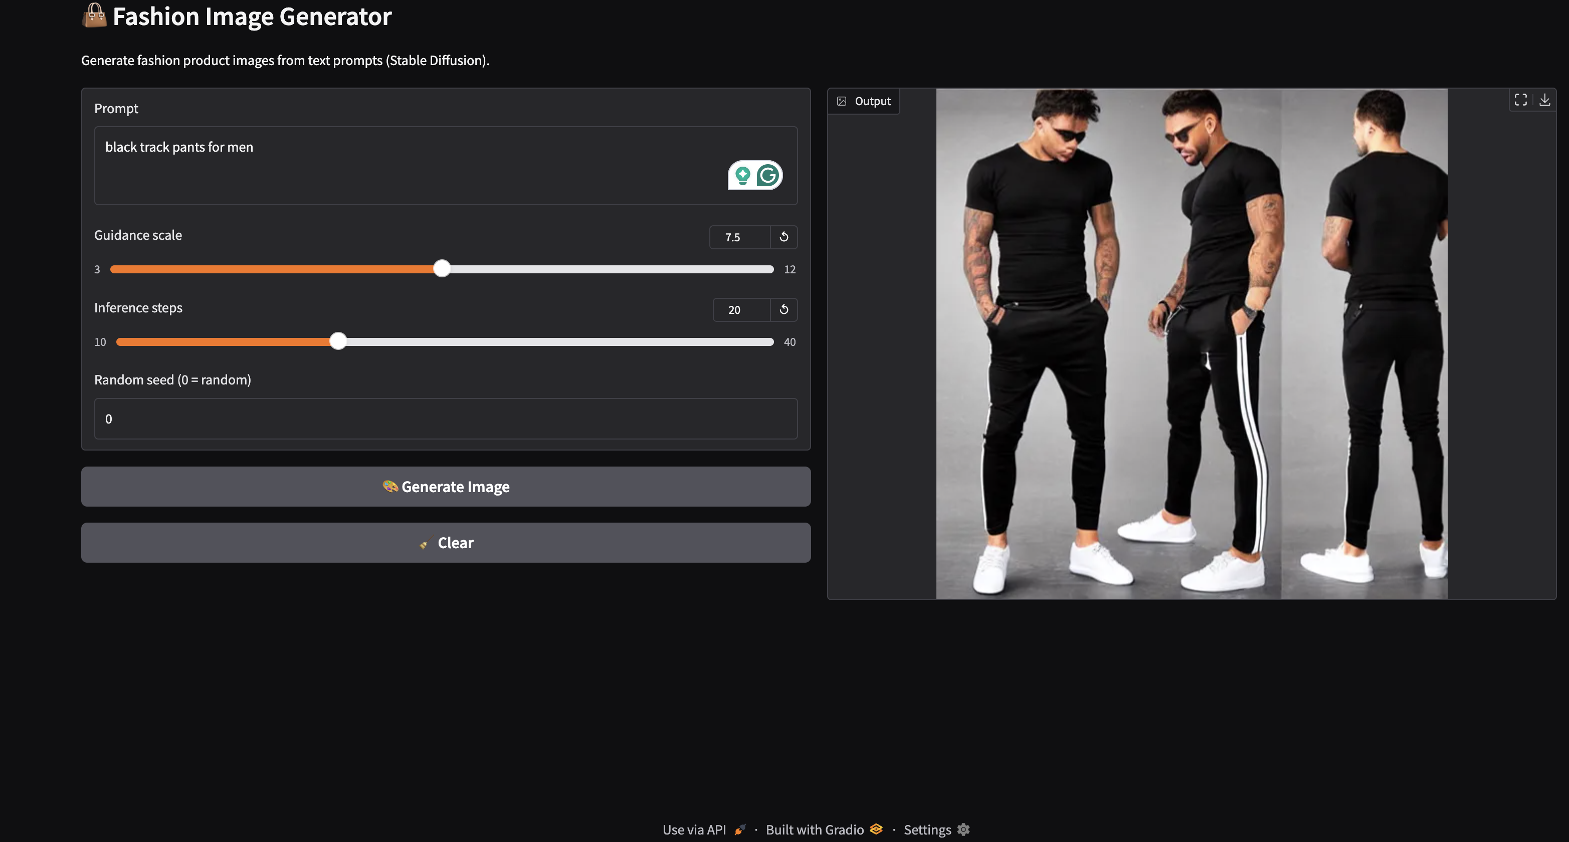
Gradio UI for Interactive Image Generation

Slide 24
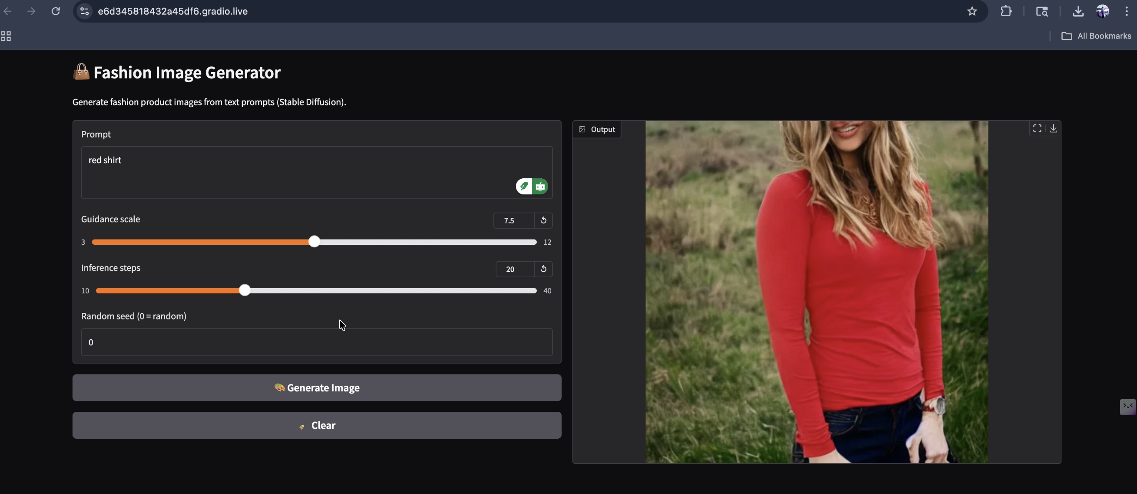
GitHub + Demo Video
Access the Full Project Repository https://github.com/nishanth3112/fashion_product_image_gen_project
Demo Video

Slide 25
Conclusion
This project successfully built a complete prompt → image generation pipeline using Stable Diffusion + CLIP an accomplished :
Processed and embedded text descriptions
Tuned multiple parameters
Evaluated with CLIP, FID, IS
Built a final gallery of 50 images
Strengths:
Good alignment with fashion prompts
Stable generation at guidance 9.0 & 50 steps
Limitations:
Low diversity (IS)
High FID
Some visual artifacts

Slide 26
Key Findings
Key Achievements
→ Successfully generated fashion images from text
→ Optimized parameters through systematic tuning
→ Compared two diffusion models
→ Achieved FID of 185.22 Key Findings
→ Euler scheduler outperforms others
→ Guidance 9 gives the best FID
→ Model choice matters less than tuning
→ Both models perform comparably

Slide 27
Future Work
→ Larger dataset
→ Fine-tuning the diffusion model
→ Optimization of scheduler choices
→ Using DreamBooth or LoRA for style control
→ Build an end-to-end product catalog pipeline

Slide 28
Thank You

